Slide 1

Bitcoin price analysis
Rohit Gampa(rgampa)
Mitali Tavildar(mtavilda)

Slide 2
Project logistics
Why bitcoin Data?
If we need to consider the social aspect affecting the price, using bitcoin is better because it is popular.
Why cryptocurrency than traditional stock market(Bitcoin Vs Tesla)
24x7, and can be granular data for free, stock data quality is bad for granular data/need to pay money to get it
Will use binance historical API to collect the data
The data has features such as open time, open prices, close time, close prices, high, low for hourly, daily and weekly data records.

Slide 3
Objectives
We aim to answer the following questions and find the best prediction model.
Which day to invest?
Which hour of the day to invest?
Impact of google trends on the price(adding this as an input for the LSTM model below)
Feature creation/ extraction for LSTM RNN model for model price prediction

Slide 4
Processing on bitcoin data:
Exploratory data analysis on the bitcoin data
Predicting gain using basic classification models
Analyzing and predicting trend using Prophet by Facebook
Google trend analysis over bitcoin searches

Slide 5
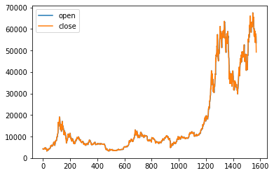
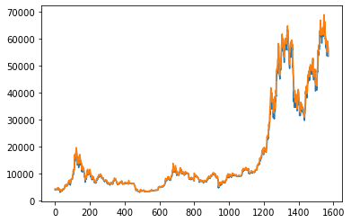
Exploratory data analysis
Open prices vs Close prices
Following are the results based on single-day records:
The lines overlap. ﻿We could use either open or close prices for further predictions.
About 53% of the records have closed at a higher price than opening price.
The max difference from opening price to the highest price was 7998 and lowest was 0.
Open prices vs high prices

Slide 6
Predicting gain using basic classification models
Predicting gain at closing for single day records:
Based on the following features:
Open price
Highest price of the day
Lowest price of the day
Prediction accuracies:
Logistic Regression : 87%
KNeighbours classifier : 71%

Slide 7
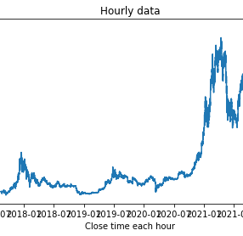
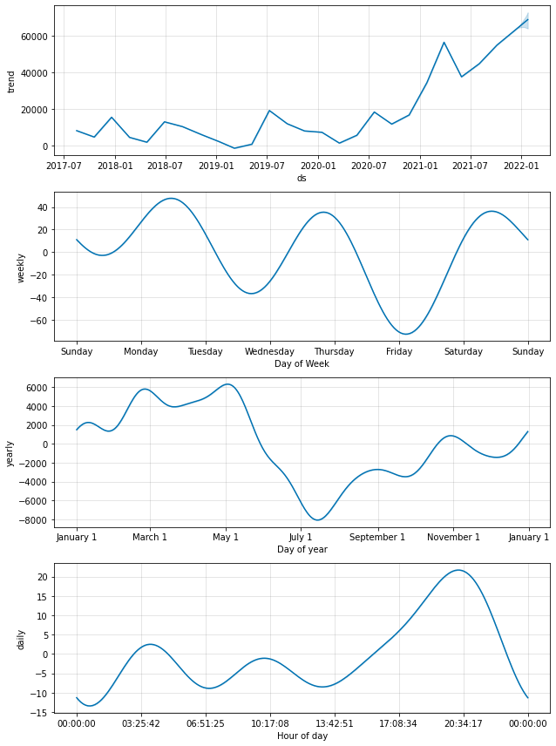
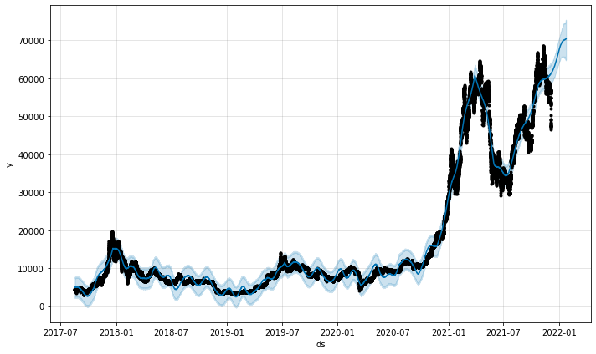
Prophet by Facebook for trend analysis
(1)Observed data
(3)Prophet components
(2) Prophet trend prediction
The Prophet model was fit on hourly recorded values of close prices.
Prophet predicts the upward trend in the hourly recorded prices (Fig2)
The components predict in Fig 3 the following:
Trend observed
Weekly trend
Yearly trend
Daily trend

Slide 8
Inferences based on trend analysis:
Best day to buy in a week : Friday
Best day to sell in a week : Monday
Best time to buy in a day : 1 am
Best time to sell in a day: 8 pm

Slide 9
Google Trend’s impact on the Price of Bitcoin
By using a python package called pytrends, I was able to get the search volumes for each day. (usually google trends website only lets you download monthly search volumes when downloading for a longer time frame.)
Downloaded google trends data for keywords that might affect the price of bitcoin. Eg: bitcoin, buy bitcoin, sell bitcoin.
One con of using google trends data is we only get search volumes , we do not know the sentiment of these searches.
So bitcoin price might increase/decrease due to the google searches.

Slide 10
LSTM model for predicting Bitcoin price using OHLCV and google trends data
Using LSTM layer in the neural network with a dropout layer after with inputs of open,high,low,close,volume,number of trades, as well as google trends data. The output we are looking for is close price of bitcoin on that day.
This is still work in progress. Working to improve the accuracy.

Slide 11
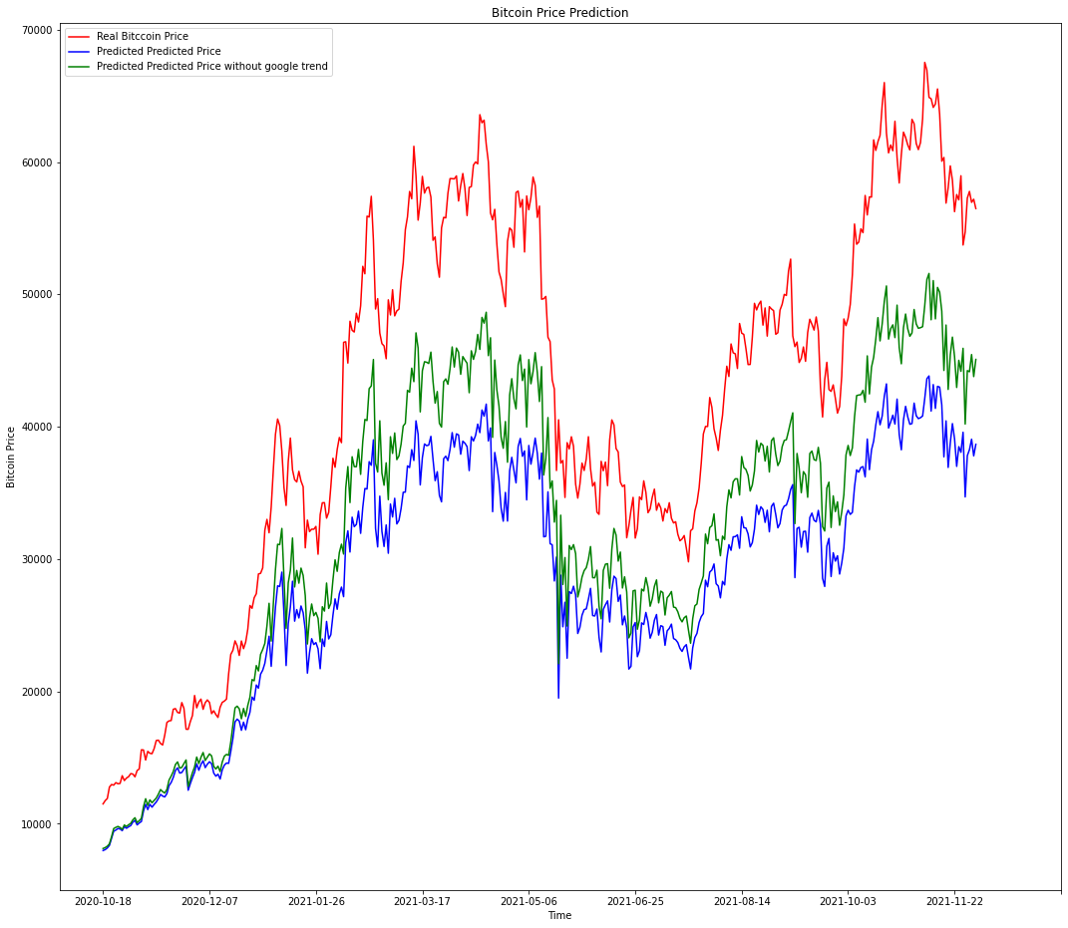
Output of the RNN(LSTM) model

